Slide 1
LLVM LTO SESSION
By
Bala

Slide 2
Linkers used in LLVM
Linkers:
ld - the GNU linker.
gold - a new, faster, ELF only linker.
LLD is a linker from the LLVM project. LLD is very fast.
This linker supports ELF (Unix), PE/COFF (Windows), Mach-O (macOS).

Slide 3
Sample Linker Performance
Program | Output size | GNU ld | GNU gold w/o threads | GNU gold w/threads | lld w/o threads | lld w/threads
ffmpeg dbg | 92 MiB | 1.72s | 1.16s | 1.01s | 0.60s | 0.35s
mysqld dbg | 154 MiB | 8.50s | 2.96s | 2.68s | 1.06s | 0.68s
clang dbg | 1.67 GiB | 104.03s | 34.18s | 23.49s | 14.82s | 5.28s
chromium dbg | 1.14 GiB | 209.05s [1] | 64.70s | 60.82s | 27.60s | 16.70s

Slide 4
Why LTO is needed?
Link Time Optimization (LTO) is a form of interprocedural optimization which, as the name suggests, is performed at the time of linking a program. This is particularly useful when building an image from multiple source files that are compiled separately. The compiler does not have complete visibility across all compilation units while compiling individual source file, therefore it misses out on many optimization opportunities which it would have had if the entire code have been a part of a single file.
We will see the examples in further section.

Slide 5
LLVM LTO advantages
Reduced code size
Increased execution speed
Dead code elimination:
Dead code elimination is one of the interesting aspects of the LTO optimizer.
Unreachable code analysis pass traverses control flow path (for the whole program). It tracks unreachable marked sections to determine whether it is reachable from other code blocks or not. If it was safe to remove, then dead-code elimination pass will eliminate unreachable parts and remaining branches form the procedures and conditional statements.

Slide 6
LLVM LTO advantages
Dead code elimination:

Slide 7
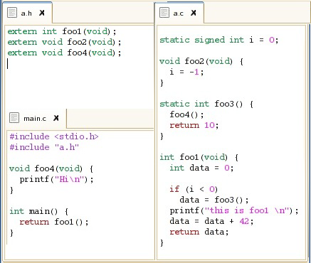
LLVM LTO advantages
Interprocedural analysis and optimization
Link time optimization extends interprocedural optimization (IPO) through whole code.

Slide 8
LLVM LTO advantages
Result for the Interprocedural analysis and optimization:

Slide 9
LLVM LTO advantages
Function inlining
To eliminate function call and return overheads, caller function can include the called. function’s body inside its own function body. It is called function inlining.
Without LTO, function inlining can just happen inside the source file scope.
A compiler with LTO support can perform extensive inlining on the whole program regardless of whether a function is defined externally or internally.

Slide 10
Downsides of LTO
Increased compile time

Slide 11
Types of LTO
Full LTO
Full LTO combines all LLVM IR code of the separate object files into one big LLVM module, and then optimizes that and generates machine code as usual.
For full LTO (-flto=full), only the semantic analysis is done in parallel, but the optimization and machine codegen is done in a single thread.
Thin LTO
ThinLTO” keeps the modules separate, but imports functions as needed from other modules and does optimization and machinecodegen in parallel.
For ThinLTO (-flto=thin), all steps are done in parallel except for a global analysis step.
Full Vs Thin
ThinLTO is therefore much faster than full LTO or all-at-once compilation, especially if you have a machine with many cores available.

Slide 12
Examples
example1.c:
extern void fun();
int main()
{
unsigned long i, j, k;
for (i=0; i<1000000000;i++)
{
fun();
}
return 0;
}
example1a.c:
extern void fun() {}

Slide 13
Execution time status
Without LTO
clang -O3 example1a.c -c -o example1a.o
clang -O3 example1.c example1a.o -o a1.out
time ./a1.out
real 0m1.229s
user 0m1.229s
sys 0m0.000s
With LTO
clang -O3 -flto example1a.c -c -o example1a.o
clang -O3 -flto example1.c example1a.o -o a2.out
time ./a2.out
real 0m0.002s
user 0m0.002s
sys 0m0.000s
With LTO(full)
clang -O3 -flto=full example1a.c -c -o example1a.o
clang -O3 -flto=full example1.c example1a.o -o a3.out
time ./a3.out
real 0m0.002s
user 0m0.002s
sys 0m0.000s
With LTO(thin)
clang -O3 -flto=thin example1a.c -c -o example1a.o
clang -O3 -flto=thin example1.c example1a.c -o a4.out
time ./a4.out
real 0m0.002s
user 0m0.001s
sys 0m0.001s

Slide 14
Verify symbols status post linking
Without LTO
$nm a1.out | grep fun
00000000004005a0 T fun
With LTO
$nm a2.out | grep fun
$
With LTO(full)
$nm a3.out | grep fun
$
With LTO(thin)?
$nm a4.out | grep fun
0000000000400580 T fun

Slide 15
LLVM IR
LLVM IR is a low-level intermediate representation used by the LLVM compiler framework. You can think of LLVM IR as a platform-independent assembly language with an infinite number of function local registers.
Compilers are therefore often split into three components, the front-end, middle-end and back-end; each with a specific task that takes IR as input and/or produces IR as output.
Front-end: compiles source language to IR.
Middle-end: optimizes IR.
Back-end: compiles IR to machine code.

Slide 16
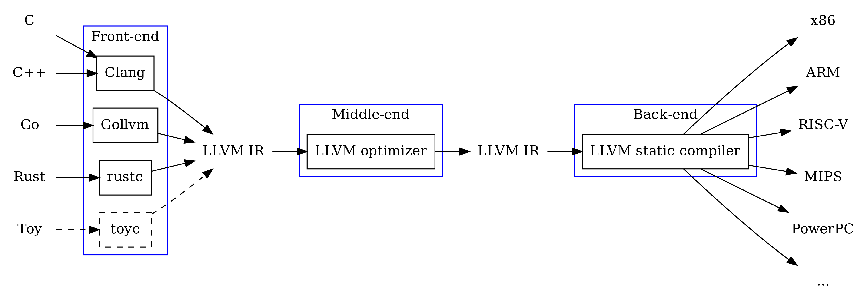
LLVM IR

Slide 17
LLVM IR
LLVM IR can be stored on disk in two formats.
Bit code
assembly text
How to generate Bit code?
clang ret.c -emit-llvm -c -o ret.bc
How to generate the assembly representation?
clang -S ret.c -emit-llvm -o ret.ii
How to convert Bit code into Assembly?
llvm-dis ret.bc -o tmp.ii
How to convert Assembly into Bit code?
llvm-as ret.ii -o tmp.bc
Sample Source code:
int main()
{
return 0;
}

Slide 18
LLVM IR
LLVM IR assembly file ‘ret.ii’
; ModuleID = 'ret.c'
source_filename = "ret.c"
target datalayout = "e-m:e-i64:64-f80:128-n8:16:32:64-S128"
target triple = "x86_64-unknown-linux-gnu"
; Function Attrs: noinline nounwind optnone uwtable
define dso_local i32 @main() #0 {
entry:
%retval = alloca i32, align 4
store i32 0, i32* %retval, align 4
ret i32 0
}
attributes #0 = { noinline nounwind optnone uwtable "correctly-rounded-divide-sqrt-fp-math"="false" "disable-tail-calls"="false" "less-precise-fpmad"="false" "no-frame-pointer-elim"="true" "no-frame-pointer-elim-non-leaf" "no-infs-fp-math"="false" "no-jump-tables"="false" "no-nans-fp-math"="false" "no-signed-zeros-fp-math"="false" "no-trapping-math"="false" "stack-protector-buffer-size"="8" "target-cpu"="x86-64" "target-features"="+fxsr,+mmx,+sse,+sse2,+x87" "unsafe-fp-math"="false" "use-soft-float"="false" }
!llvm.module.flags = !{!0}
!llvm.ident = !{!1}
!0 = !{i32 1, !"wchar_size", i32 4}
!1 = !{!"clang version 8.0.0 (trunk 339662) (llvm/trunk 339654)"}

Slide 19
LLVM IR
Function definition:
define dso_local i32 @main() #0
This defines a function called main that returns a 32 bit integer. The #0 means to use the attributes named #0 for the function. For example, there may be something like attributes #0 = { alwaysinline alignstack=4 } in the IR, and these attributes will be applied to main.
dso_preemptable
Indicates that the function or variable may be replaced by a symbol from outside the linkage unit at runtime.
dso_local
The compiler may assume that a function or variable marked as dso_local will resolve to a symbol within the same linkage unit. Direct access will be generated even if the definition is not within this compilation unit.
%retval = alloca i32, align 4
This allocates an 32 bit integer on the stack. %retval is the name of a pointer to this location on the stack. The align 4 ensures that the address will be a multiple of 4.

Slide 20
LLVM IR
Function definition:
store i32 0, i32* %retval, align 4
This sets the 32 bit integer pointed to by %retval to the 32 bit value 0. It's like saying *x = 1 in C++.
ret i32 0
This returns from the function with a 32 bit return value of 0.

Slide 21
LLVM IR
Function attributes:
noinline:
This attribute indicates that the inliner should never inline this function in any situation.
nounwind:
This function attribute indicates that the function never raises an exception. If the function does raise an exception, its runtime behavior is undefined.
Optnone:
This function attribute indicates that most optimization passes will skip this function, with the exception of interprocedural optimization passes.
Uwtable
Exception tables are necessary to handle exceptions thrown by functions in high-level languages such as C++. Unwind tables contain debug frame information which is also necessary for the handling of such exceptions. An exception can only propagate through a function with an unwind table.
This attribute indicates that the ABI being targeted requires that an unwind table entry be produced for this function even if we can show that no exceptions passes by it. This is normally the case for the ELF x86-64 abi, but it can be disabled for some compilation units.

Slide 22
LLVM IR
Function attributes:
correctly-rounded-divide-sqrt-fp-math:
Specify that single precision floating-point divide and sqrt used in the program source are correctly rounded.
disable-tail-calls:
disable tailcall optimizations.
The tail recursive functions considered better than non tail recursive functions as tail-recursion can be optimized by compiler. The idea used by compilers to optimize tail-recursive functions is simple, since the recursive call is the last statement, there is nothing left to do in the current function, so saving the current function’s stack frame is of no use.

Slide 23
LLVM IR
Function attributes:
disable-tail-calls:
Before tail-call optimization:
// An example of tail recursive function
void print(int n)
{
if (n < 0)
return;
cout << " " << n;
// The last executed statement is recursive call
print(n-1);
}

Slide 24
LLVM IR
Function attributes:
After tail-call optimization:
// Above code after tail call elimination
void print(int n)
{
start:
if (n < 0)
return;
cout << " " << n;
// Update parameters of recursive call
// and replace recursive call with goto
n = n-1
goto start;
}

Slide 25
LLVM IR
Function attributes:
no-frame-pointer-elim/no-frame-pointer-elim-non-leaf
Specify effect of frame pointer elimination optimization (all,non-leaf,none).
no-infs-fp-math:
Enable/disable optimizations that assume no Inf values.
no-nans-fp-math:
Enable/disable optimizations that assume no NAN values.
unsafe-fp-math:
Enable optimizations that make unsafe assumptions about IEEE math (e.g. that addition is associative) or may not work for all input ranges. These optimizations allow the code generator to make use of some instructions which would otherwise not be usable (such as fsin on X86).
no-signed-zeros-fp-math:
for floating point arithmetic that ignore the signedness of zero.

